Slide 1
Graphics for Games
Particle Systems
CO2301 Games Development 1
Week 23

Slide 2
Lecture Contents
Particle System Examples
Types of Particle
Particle Data and External Forces
Particle Update
Emitters and Other Features
Technical Considerations

Slide 3
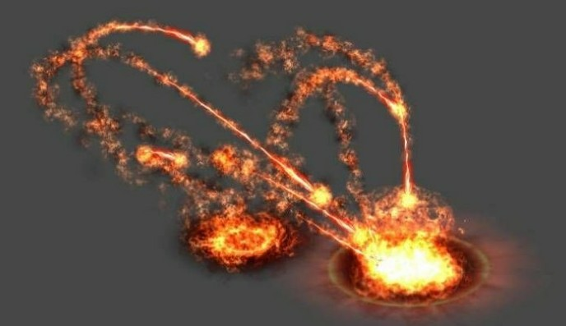
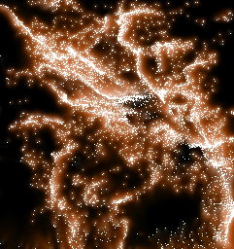
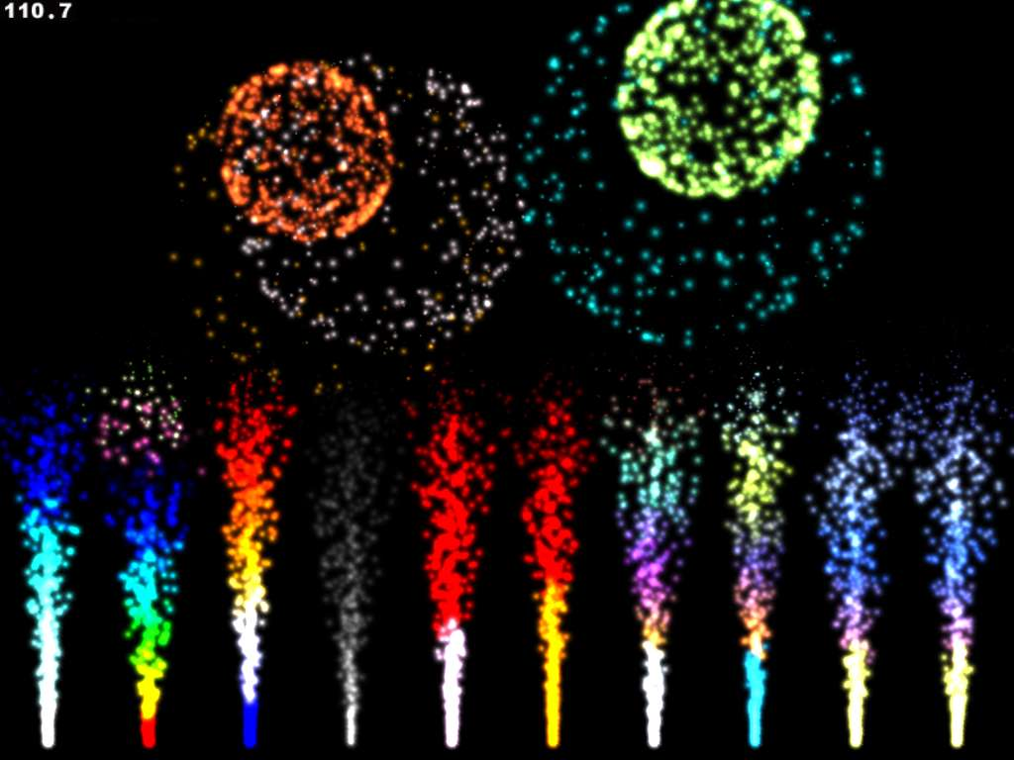
Particle Systems
A particle system is a collection of sprites or models:
  Usually each is small
  May be a large number
  Each follows a simple motion
Combined they create complex visual effects
Used for:
  Fire, smoke
  Water
  Special effects, etc.

Slide 4
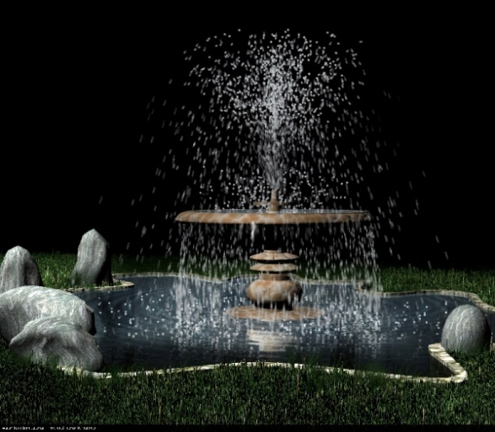
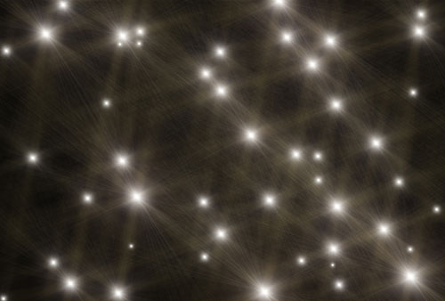

Types of Particle
Each particle may be a 3D model, e.g.:
  Rocks coming from a volcano
  Leaves falling from a tree
More commonly, each particle is a sprite
  Typically the sprite is made to always face the camera
  And scale with distance
  i.e. It appears to be 3D
  E.g. Use a flare sprite for a firework particle system

Slide 5
Core Particle Data
We store a list of particles
  Typically use a simple structure for performance
  There may be a very lot of particles, so performance is key
Typical data required for each particle:
  Position in space, a 3D point
  Velocity, a 3D vector
    Not just speed, as we need direction of travel too
  Life, a float:
    Particles in most systems don’t last forever
    The life value is a countdown clock
    When it reaches 0, particle is destroyed
    Important to keep number of particles under control

Slide 6
External Forces
Each particle’s velocity must change, or it will only move in a straight line
  A change in velocity is called an Acceleration
  Acceleration caused by external Force on particle
  So we’re interested in the forces on the particle. Gravity is the most common force, but also wind, explosions or artificial effects
Define all the forces affecting the particle
  Sum all the forces to get the overall force
How to convert force to acceleration?
  Newtonian physics: F = ma
  m is the mass of the particle, often assumed to be 1 for particle systems, i.e. we can use force value for acceleration

Slide 7
Particle Update
This is sufficient information to update the particle system each frame:
  Go through the list of particles
  Find overall force acting on each one
    E.g. gravity + wind
  Turn this to an acceleration
    Take account of particle mass or not (usually not)
  Add acceleration to velocity
  Add velocity to position
  Decrease life
  If life <= 0, remove particle from system

Slide 8
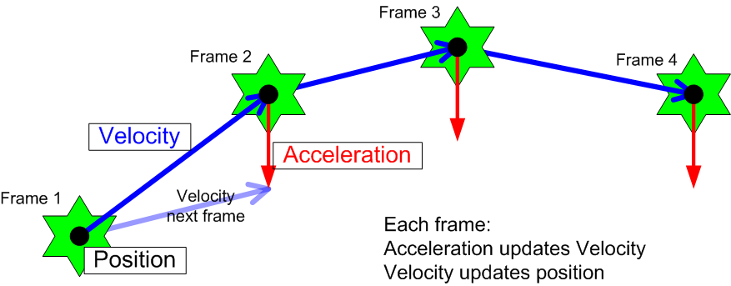
Particle Update Example

Slide 9
Frame Timing
This is simple physics, velocities and accelerations are measured in physical units
  Velocity: metres per second (ms⁻¹)
  Acceleration: metres per second per second (ms⁻²)
  Force: kilogram metres per second per second (kg ms⁻², or N)
We update particles every frame, not once per second
  But the physical units are convenient and intuitive
So take account of time taken for each frame when applying acceleration / velocity:
  Measure frame time
  Multiply velocity and acceleration by frame-time
    Same as game loop timing

Slide 10

Emitters
Have seen how to update and destroy particles particles
  Simple physics and life countdown
But how are particles created?
We might initialise the system with some particles. But also many particle systems contain an emitter
  Point, area or volume that spawns particles
  Emitters have various settings:
    Location, size, etc.
    Time period between emitting each particles
    Initial particle data, e.g. starting velocity for particles
  Common for these settings to be somewhat randomised, e.g. time period is 1s ±0.2s

Slide 11
More Advanced Features
These are the most basic elements of a particle system, we can add many more features:
  Particle rotation / spin
  Scaling, particles get bigger / smaller over time
  Particle colour (and colour change)
  Transparency (particles fade out)
  Emitter movement
  Repulsors & Attractors – create forces
  Combined systems (multiple particle types / behaviour to create effect, e.g. fire + smoke)

Slide 12
Technical Considerations
We can store / render a simple list of models for a basic particle system
However, systems may manage over 1,000,000 particles in real-time
  Iterating through so many objects will be too slow
Need optimisation and specialised techniques:
  Efficient structures for particles (little OO)
  Instancing, hardware supported technique to render many models in one draw call
  DirectX10+ has geometry shaders and stream-out functionality, which can be leveraged
  Will cover all this in the third year…

